Slide 1
Unlocking the Secrets of Brain-Body Energy Dynamics in Movement
Morteza Khosrotabar
ANSYMB WiSe2425

Slide 2
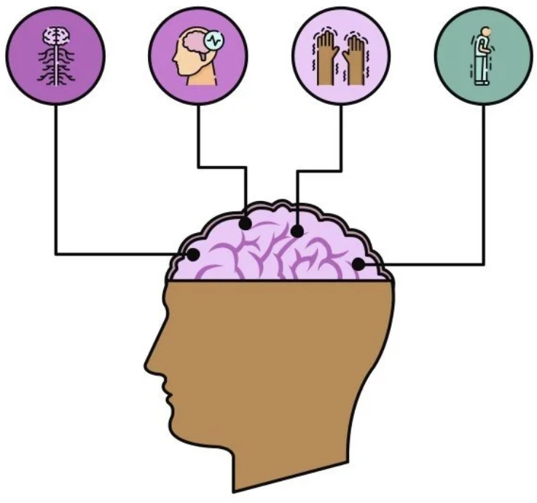
Why is this research important?
Understanding how the brain controls movement and energy use.
Linking brain signals with metabolic cost to revolutionize assistive technologies.
Opportunity to contribute to life-changing innovations.

Slide 3
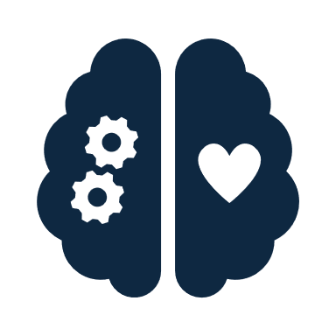


What Are We Trying to Discover?
How does brain activity change with different walking speeds and carried weights?
Can we find patterns that link brain signals to energy expenditure (COT)?
How can this knowledge improve the design of assistive devices?

Slide 4
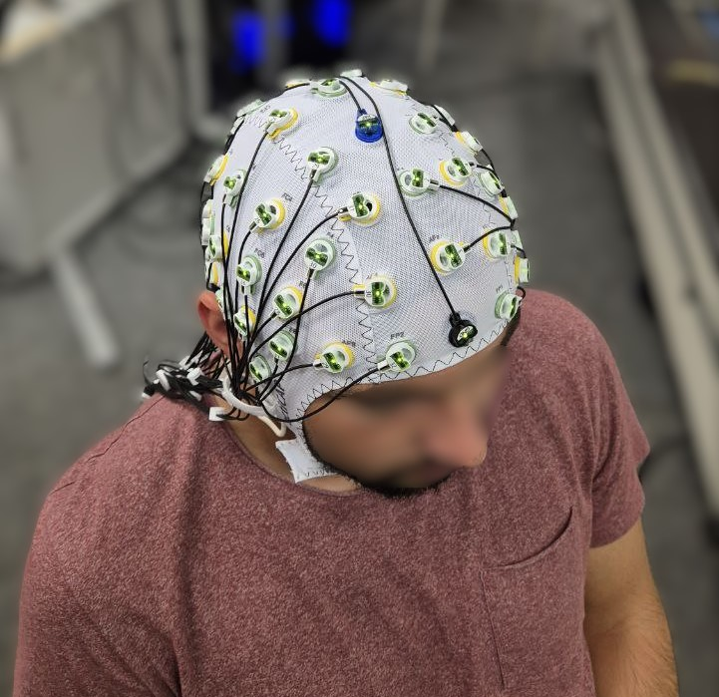
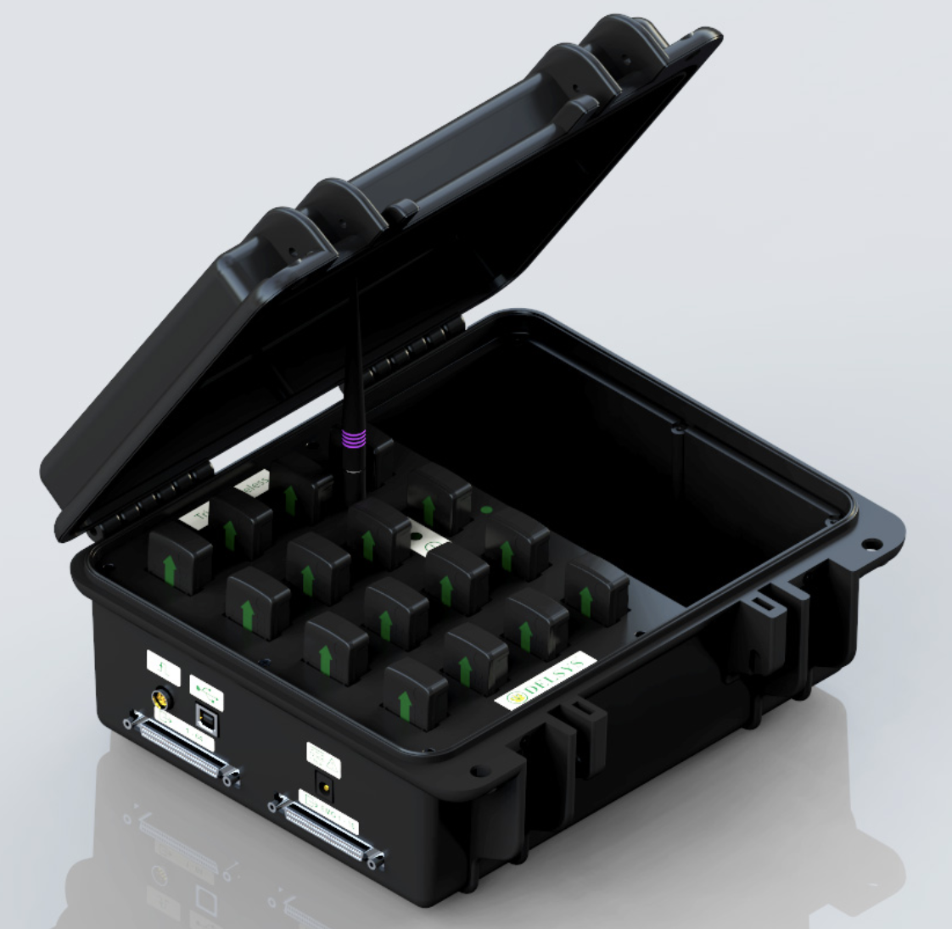
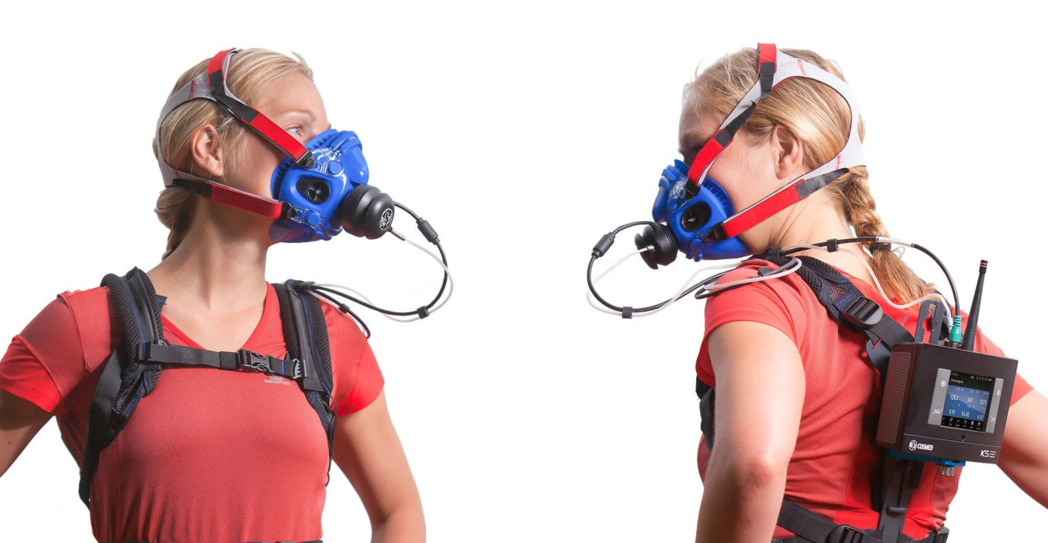
Our Methodology: How Do We Measure This?
EEG & EMG: Recording brain and muscle activity during walking.
Indirect Calorimetry (K5 Device): Measuring the cost of transport (COT).
Combining these measurements to understand the brain-energy link.
64-channels EEG System by Brain Product
16 Wireless EMG sensors by Delsys group
K5 device from COSMED The Metabolic Company
https://delsyseurope.com/trigno/
https://www.cosmed.com/de/produkte/spiroergometrie/k5

Slide 5
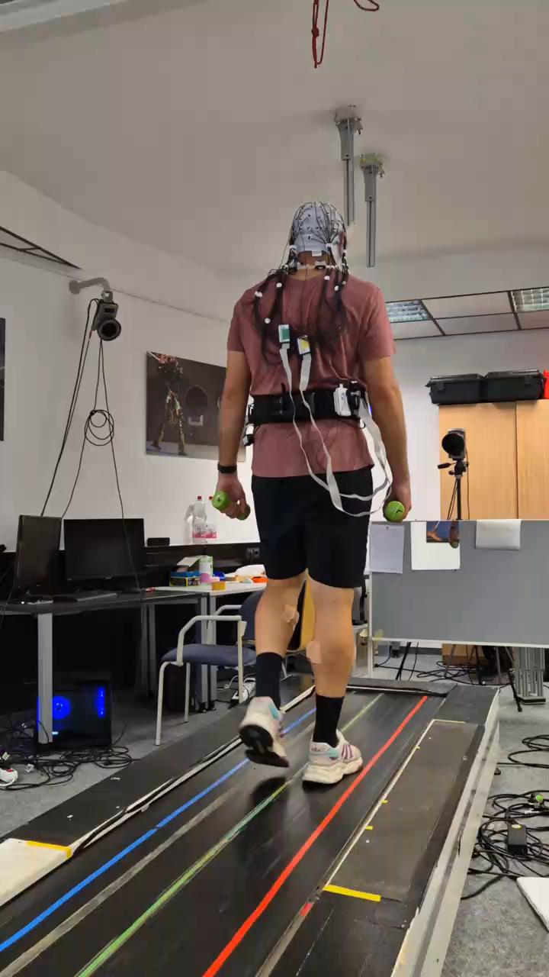
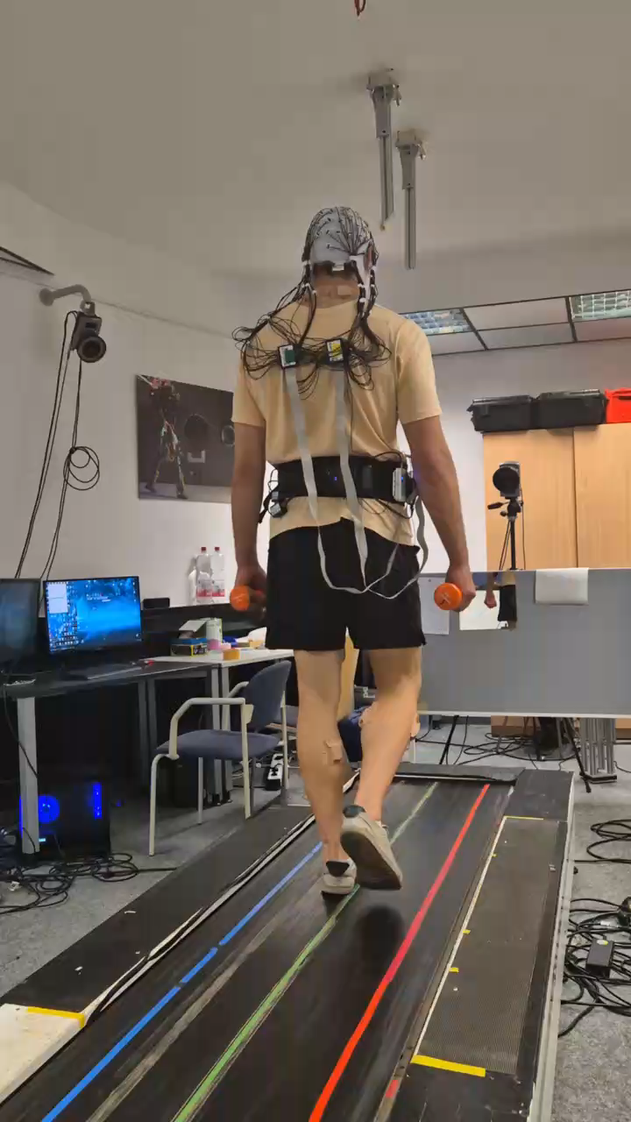
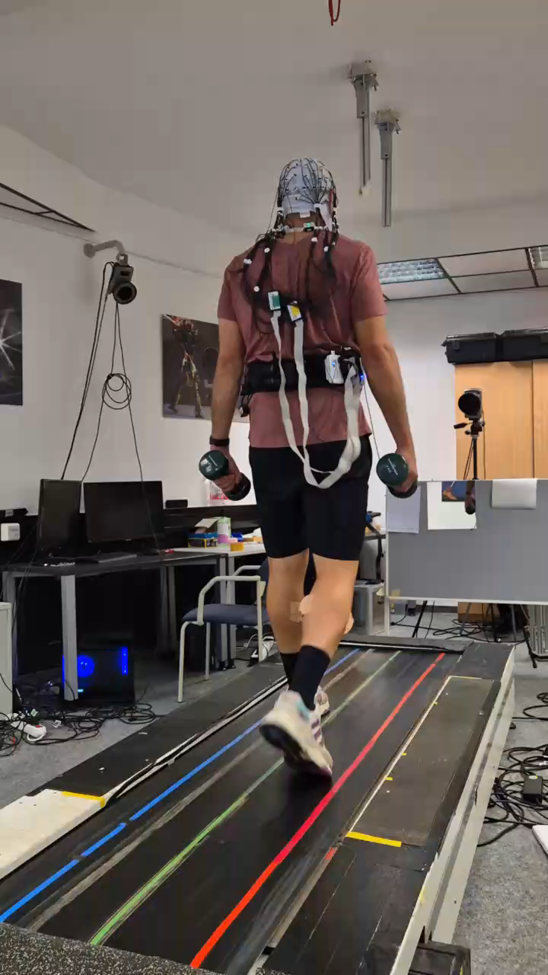

Exploring Different Walking Conditions
Variable Speeds: Slow, moderate, and fast walking.
Variable Loads: Carrying light, medium, and heavy weights.
Objective: Observe how these variables affect brain activity and energy expenditure.
2*1kg
2*2kg
2*4kg

Slide 6

What Will You Do?
Data Collection:
Conduct experiments using EEG, EMG, and the K5 device.
Data Analysis:
Learn to process and interpret neurological, muscular, and metabolic data.
Collaboration:
Work with a multidisciplinary team of researchers and fellow students.

Slide 7
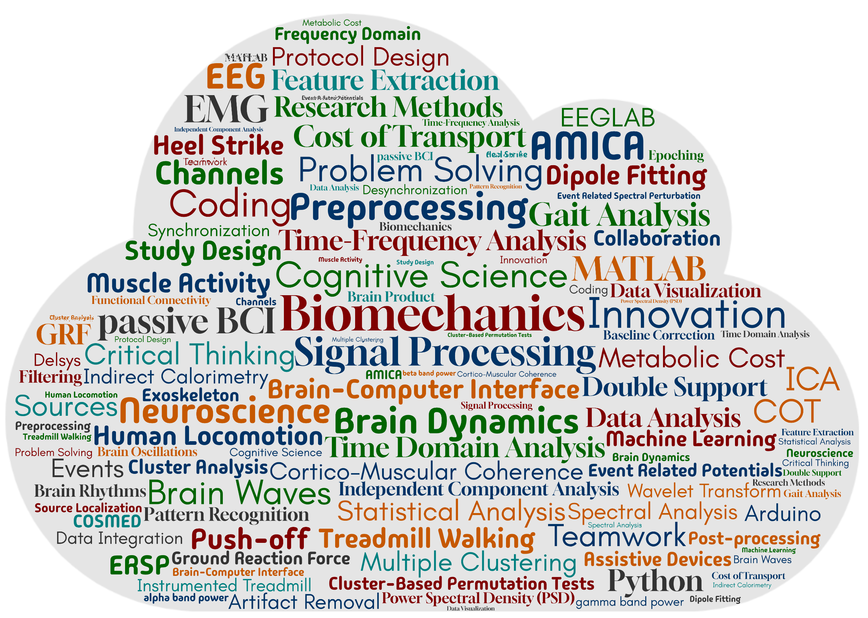
Skills and Knowledge You'll Gain
Hands-on experience with cutting-edge neuroscience and biomechanics measurement tools.
Developing knowledge about the neural mechanisms underlying human movement.
Proficiency in data analysis and research methodologies.

Slide 8

Thank You for Your Attention!
Any Questions?

